Slide 1
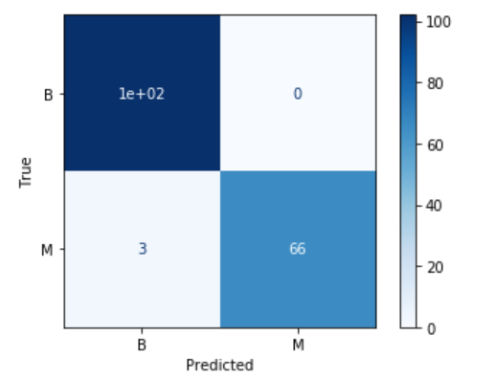
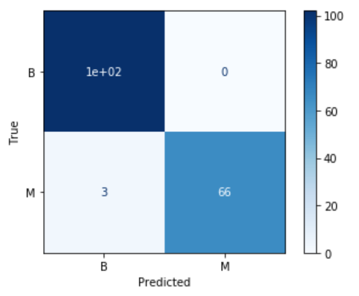


Logistic Regression – 5 features
Logistic Regression – 4 features

Slide 2

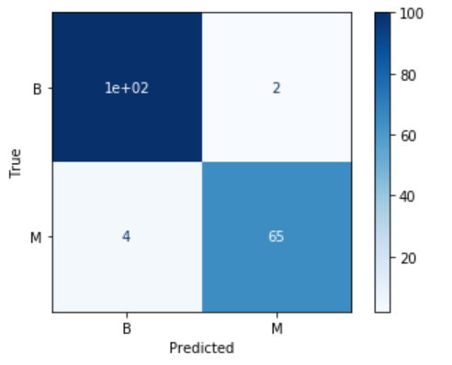
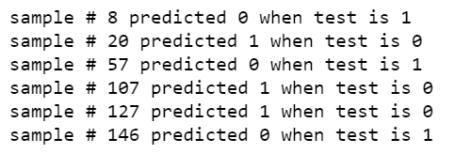

Random Forest – 5 features
Random Forest – 4 features

Slide 3




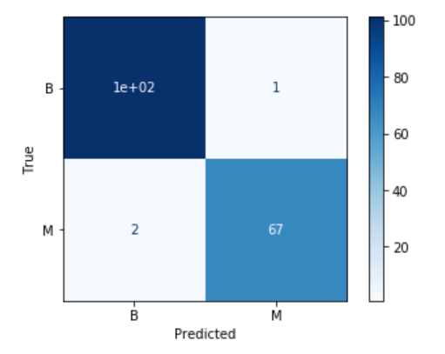
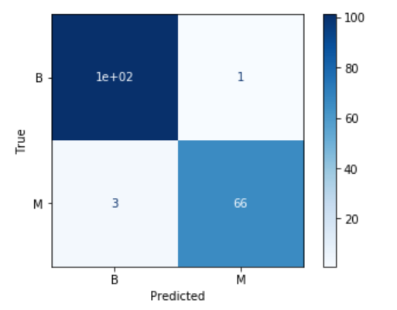
Voting – 5 features
Voting – 4 features

Slide 4


Stacking – 5 features
Stacking – 4 features

